Slide 1
Science task presentation
1.science plan
1.1(soil collection)
First part of the science plan is based upon collecting the soil sample and sensing the data through all the sensors.
a)Soil collection assembly
-The rover collects the soil sample using drill assembly which uses an Archimedes screw.
(EN8 is used for the manufacturing of screw considering strength, hardness, machinability, cost and availability. It is a popular grade unalloyed medium carbon steel readily machinable in all conditions.)
- The rover anchors itself in the ground while a drill lowers and begins to drill into the soil. 10-20 gm of soil from 5cm deep is brought up to the surface, and collected inside the container.
- A rotating mechanism is designed to collect the soil sample in 8 different compartments of a single container to perform various tests and operations for data analysis.
(The container is made up of ABS which is a thermoplastic polymer with high Chemical Resistance, Excellent High and Low Temperature Performance, great electrical insulation properties.)

Slide 2
b)Design assembly
-Design assembly consists of driller system which is controlled by dc motor and its linear motion controlled by linear actuator for soil collection.
-Rotating soil container system is controlled by another motor, the container is rotating with the help of plate attached with a gear. The system is provided with lid screw mechanism which converts rotational motion of container plate to linear motion to kept the machinery well above ground when not in use.
1.2(Soil sample analysis)
second part of the science plan is based upon analysing the soil sample through various sensors onboard
- Analysis of various soil nutrients and minerals which support the presence Of biological life.
-Analysis of soil erosion pattern.
-Analysis of soil moisture content for controlling exchange of heat and water energy.
-Analysis soil salinity and electrical conductivity for presence of dissolved salts.
-Analysis of soil pH for nutrient availability.
-Determination of cation exchange capacity (CEC) of soil.
-Determination of sub-soil temperature.

Slide 3
1.3(Atmospheric analysis)
third part of the science plan is based upon analysing the atmosphere and sensing the data through all the sensors.
- Analysis of various gases (like green-house gases) present in the atmosphere using gas sensors.
- Analysis of various atmospheric parameters such as atmospheric pressure, temperature, relative humidity
- Analysis of radiation level present at the given geographical area.(particularly we are detecting the levels of ultra-violet, infrared and visible light in the site).
1.4(topographic analysis)
fourth part of the science plan is based upon understand the topography of land surface by determining the configurations of the land surface, overall shape and size of the selected site, its aspect (position with respect to compass coordinates). We have determined:
1. shape and size of site
2. GPS coordinates
3. Cardinal directions
4. elevation level of each site
5. Soil erosion pattern

Slide 4
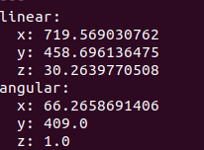
2.Data analysis
Atmospheric Analysis
a)Atmospheric temperature
We determined the atmospheric temperature value since it has significant role on the cells, metabolism, life distribution, growth (growth rates of different species is also influenced by temperature).The temperature on mars is much colder than on earth, it ranges from (-60 to 80).
TEMPERATURE(in degree celcius) : 30.2

Slide 5
b)Relative humidity
We determined the relative humidity since it plays an important role for surface life. High humidity impairs heat exchange efficiency by reducing the rate of moisture evaporation from skin surfaces.
RELATIVE HUMIDITY(percentage) : 66.26
.

Slide 6
c)Atmospheric pressure
We determined the atmospheric pressure value, since it determines the amount of gases dissolve in atmosphere, without atmospheric pressure intermolecular forces will be insufficient to hold water molecule in liquid form and it would evaporate away, hence no life possible. It varies with elevation as well as season (it happens due to change in amount of CO2 gas in the atmosphere with the seasons).
ATMOSPHERIC PRESSURE(in mm Hg): 719.56

Slide 7
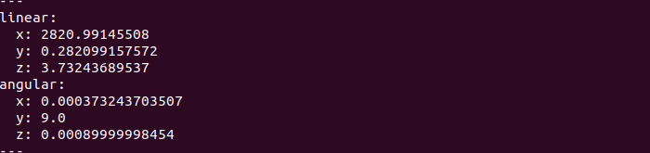
d)Green-house gases
we detected the presence of green-house gases (CO2, CH4) because they play an important role in maintaining warm climate for life sustainability.
METHANE CONCENTRATION(in ppm): 2820.99
METHANE PERCENTAGE COMPOSITION: 0.28%
CARBON-MONOXIDE CONCENTRATION(in ppm): 3.73
CARBON-MONOXIDE COMPOSITION: 0.0003%

Slide 8
e)Hydrogen gas
We detected the presence of hydrogen since it is the basic constituent of chemical compounds such as water and hydro-carbons (they are the basic units of biomolecules useful for functioning of living organisms).
HYDROGEN CONCENTRATION(in ppm): 9.00
HYDROGEN PERCENTAGE COMPOSITION: 0.0008%

Slide 9
f)Tvoc levels
We detected the presence of total volatile organic compounds since it plays an important role in communication between plants, and messages from plants to animals.
TOTAL VOLATILE ORGANIC COMPOUND(in ppb):1.0

Slide 10
g) Radiation levels
We determined the presence of UV and IR radiation, since extreme radiation conditions are harmful (low radiation impacts cell growth) and (high radiation affects the atom in living things by damaging tissues and altering DNA).
LUMINOSITY( in lux / lumens per square meter):
UV (UV index value):

Slide 11
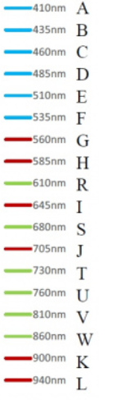
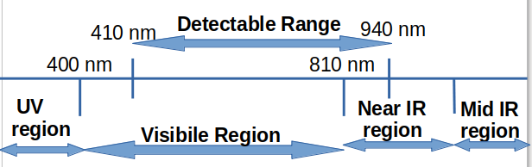
Soil Sample Analysis
a)Soil composition
-We used the emission spectroscopy technique to detect the presence of various minerals and nutrients. In emission spectrum, the radiation impinges on substance and electrons in atoms makes transition from high to low energy state and each transition corresponds to a wavelength forming an emission spectrum.
-A graph is plotted between wavelength and intensity values at different wavelength and the presence of elements/compounds detected from peaks corresponding to a particular wavelength.

Slide 12
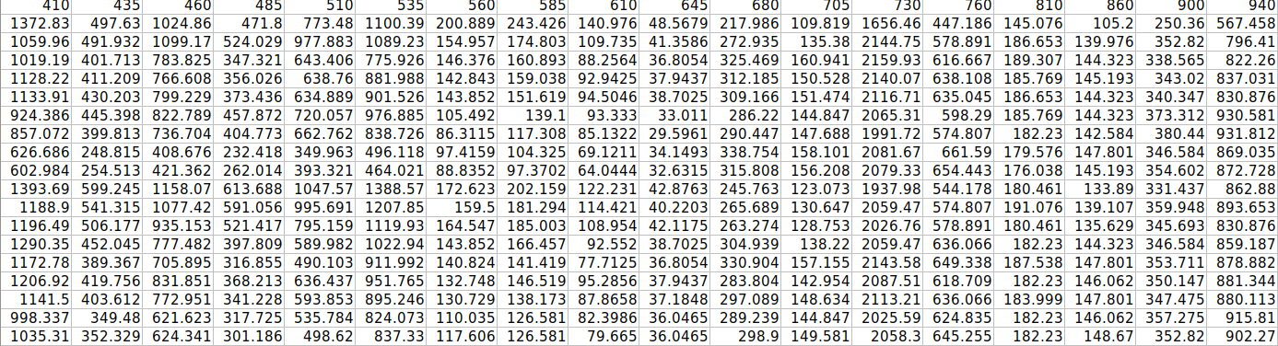
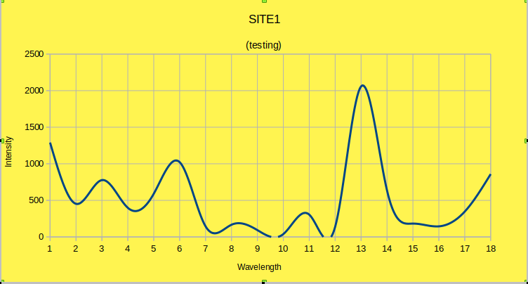
Site 1

Slide 13
SOIL COMPOSITION: Aluminium-,silicon-,calcium-,-calcium(2)ion
Chromium,-carbohydrates
-Manganese(2),-nucleic acids,-nickel(1),-boron(small amt),compound with P-O bond,
-Sodium,-chlorides,-boron(very small)
-Titanium
Potassium, -oxygen,iron(1,2)
-presence of bulk elements (O, C, H, N and S), macro-minerals (Na, Mg, K, Ca, Cl, and P) and Boron important for biological survival since it stabilizes the sugar ribose which indicates presence of RNA.
-presence of compounds ( Cl-, CO ²⁻ ₃, NO₃-, SO²⁻ ₄, NO₂−, Fe, Ca, Mg) indicates presence of water in soil.
-Nitrate and nitrite indicate the presence of the bacteria in the soil.
-Biomarkers such as proteins(dating of dead cells can be found with the amino acids), lipids(when cells are exposed to stressful conditions their lipids change structure ), carbohydrates, nucleic acid are vital for every single organism important for cellular functioning.

Slide 14
Elements/Minerals/Nutrients | Approximate quantity | Inference
Macro-mineral Aluminium,Silicon,Calcium,Sodium, Potassium | Low values | Presence of bulk elements and macro-minerals are important for biological survival.
Bulk Elements Oxygen,Carbon
Boron | Very low value
Bio-markers Carbohydrates,Nucleic acids
Ions Calcium(2),Nickel(1),Manganese(2), Chlrorides
Titanium,chromium

Slide 15
b)Soil moisture
-presence of moisture in soil indicates the presence of dissolved salts makes up the soil solution and it supplies the nutrients to growing plants.
-It is a key factor in controlling the exchange of water and heat energy between land surface and atmosphere.
SOIL MOISTURE (percentage value):
ss of value

Slide 16
c)Soil Erosion pattern(from soil moisture content)
-presence of high values of soil moisture increases the soil compactness thus creating lumps which loosens the top-soil allowing small fragments to detach and it increases the soil erosion
-It also depends on the topography of the surface, if the land is sloped there is a greater potential for soil erosion and soil materials moves down the slope.
Soil erosion value high/low

Slide 17
d)Soil salinity and electrical conductivity
Detection of soil electrical conductivity (EC) measures the amount of salt in soil (salinity of soil), It indicates soil health and correlated to concentrations of (NO3-, K, Na, Cl-, SO²⁻ ₄, and NH3). For certain non-saline soils, determining EC estimates the amount of nitrogen (N) available for plant growth.
ELECTRICAL CONDUCTIVITY (ms/cm):
[High EC value : saline soil] /[Low EC value : non saline soil]
ss of value

Slide 18
e)cation exchange capacity(CEC)
The cation exchange capacity of soil is related to the amount and type of clay and organic matter content in the soil and it is correlated with the values of electrical conductivity.
CEC value High/Low
[High EC value – high CEC]
[Low EC value – low CEC]

Slide 19
f)Soil pH
we detected the soil pH since it influences several soil factors affecting plant growth such as soil bacteria, nutrient leaching, nutrient availability, toxic elements, and soil structure and the relative acidity or alkalinity of soil is indicated by its pH.
SOIL pH (value):
ss of value

Slide 20
g)Sub soil temperature
We detected the soil temperature directly since it affects the plant growth. Germination of various seeds requires different soil temperature ranges. Soil temperature influences aeration, soil moisture content, and the availability of plant nutrients.
SUB SOIL TEMPERATURE(in degree celcius):
ss of value

Slide 21
Topographic Analysis
a) Shape and size of site
-We analysed the field site using LIDAR to form a 2D-mapping of the task site.
ss of lidar Image
-We analysed the task sites using wide angle panoramic view.
ss of panoramic view
b) GPS coordinates
c) Cardinal directions
ss of GPS,cardinal direction

Slide 22
d) elevation level of each site
-We determined the elevation levels of various task sites to predict the geography of surface since it entails the delineation and characterization of regions on mars.
ELEVATION LEVEL( in metre from sea-level):
ss of alt level
Correlation with mars
The geography of Mars, entails the delineation and characterization of regions on surface, it is the distribution of physical features across Mars and their cartographic representations.
(Olympus mon is the highest peak in the solar system and Valles Marineris, a canyon that dwarfs Grand canyon. The difference between highest and lowest points is nearly 30km.)

Slide 23
e) Soil erosion pattern(from topographic analysis)
image of soil pattern

